Slide 1
Contract Monthly Claim System
Automation & Enhancement
PROG6212 - POE
Ezekiel Isaac Narayanasami
ST10359128

Slide 2
What this presentation covers
Short overview of the CMCS web application
How I used automation for:
Lecturers
Managers / Coordinators
HR
How I improved the system using feedback from Part 2
Security, validation and error handling
Final reflection on what I learned

Slide 3
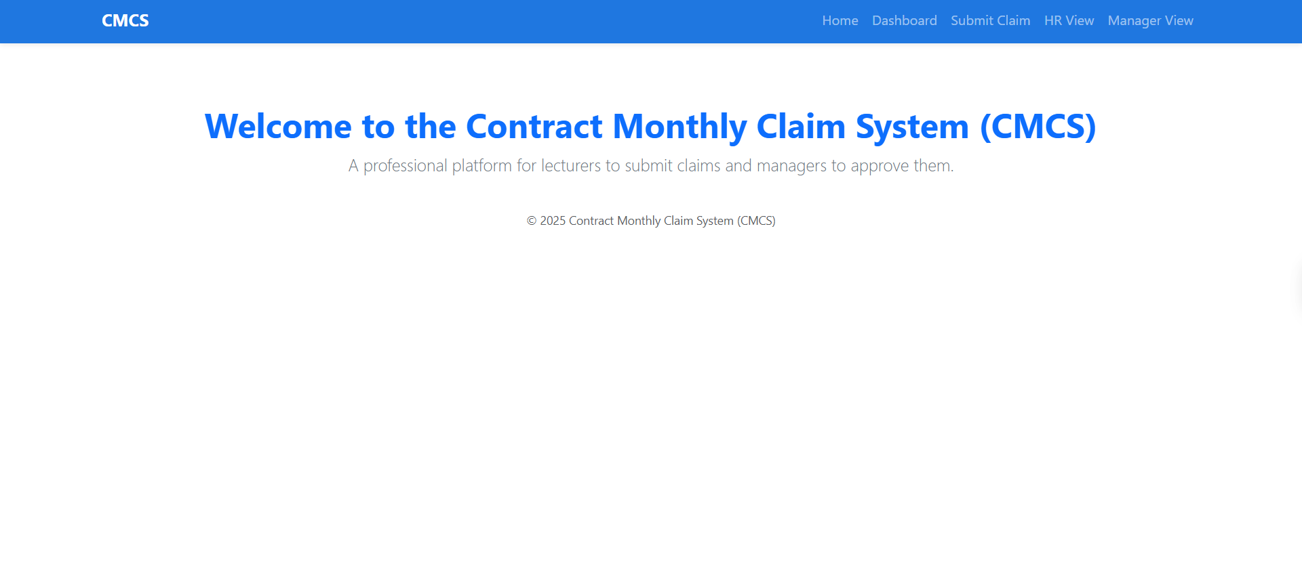
Scenario & Problem
Independent Contractor lecturers
They submit monthly claims for hours worked
Previously, this was manual and could lead to:
Errors in hours / rates
Missing supporting documents
Delays in approvals
My goal was to build a web-based CMCS that:
Automates claim submission
Helps managers approve or reject quickly
Gives HR a clear summary of what must be paid

Slide 4
System Overview
Built using ASP.NET Core MVC
Uses:
Models to store claim data
Controllers to handle logic
Views for the web pages
Three main user perspectives:
Lecturer - submits claims
Manager / Coordinator - approves or rejects
HR - views totals, stats and exports data
All claims are stored in a shared in-memory list for this POE

Slide 5
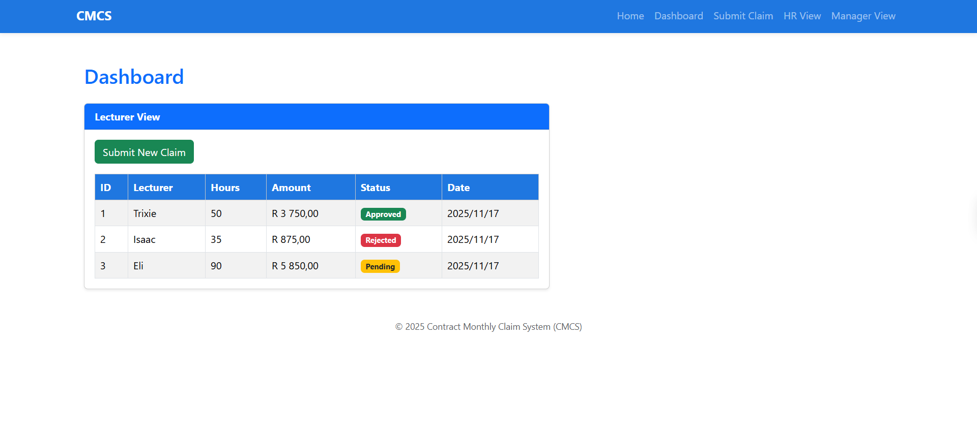

Slide 6
Lecturer View - Automation
Lecturers use the Submit Claim page to capture:
Name, hours worked, hourly rate, notes
Upload a supporting document (PDF, DOCX, XLSX)
The system automatically calculates the Amount = Hours × Hourly Rate
I added validation so that:
All required fields must be filled in
Hours and rate must be greater than 0
Large or incorrect file types are blocked
If there is an error, the page keeps the values and shows a clear message

Slide 7
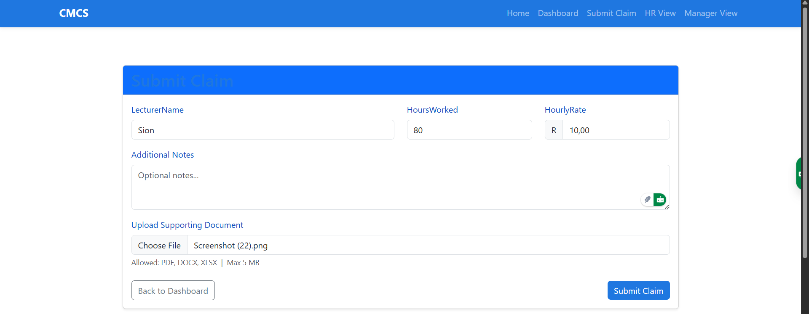
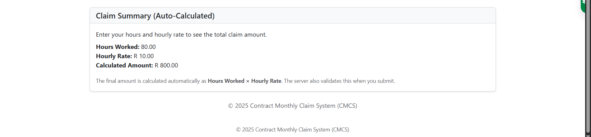

Slide 8
Lecturer Dashboard - Claim Tracking
The Dashboard shows the lecturer’s previous claims
Each claim displays:
Claim ID
Hours worked
Calculated amount
Status: Pending / Approved / Rejected
Date submitted
After a successful submission:
The system shows a success message
The new claim appears in the table automatically

Slide 9
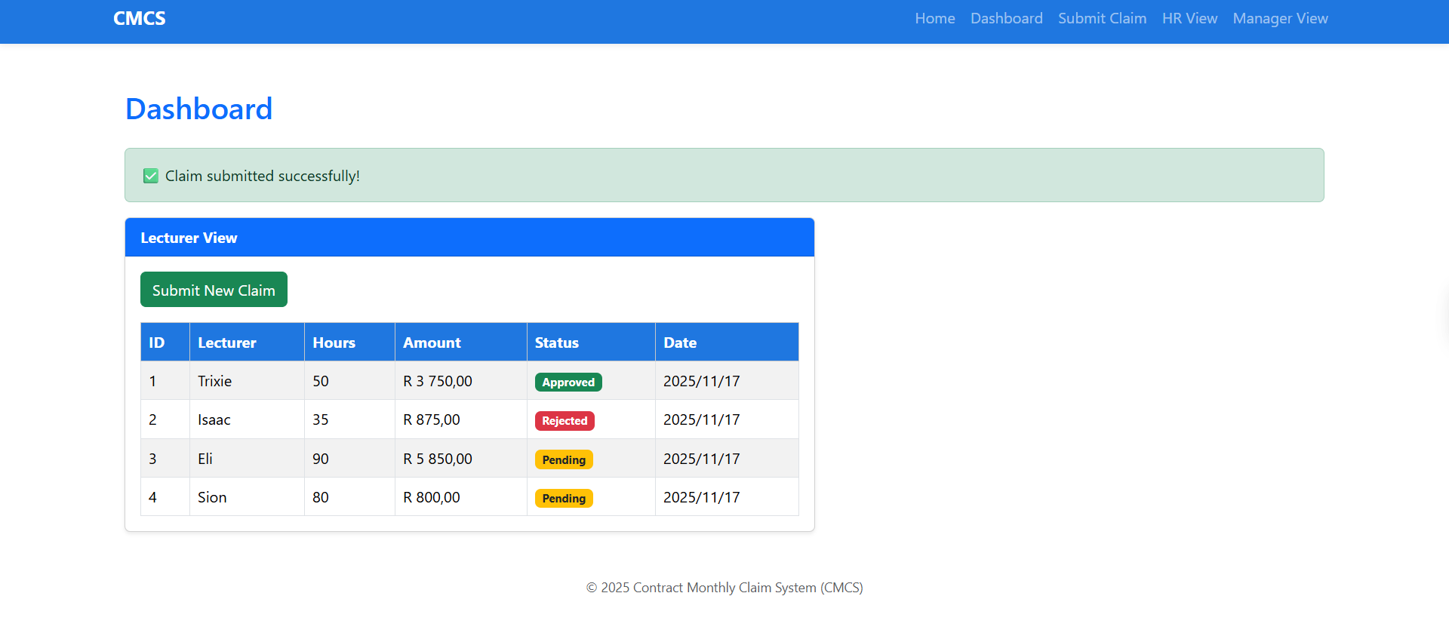

Slide 10
Manager View - Approvals & Decisions
Managers access a separate Manager View page
This view is not mixed with the lecturer dashboard
Managers can:
See all claims with hours, rate, amount and status
View the uploaded file name for each claim
Approve or reject each claim using buttons
When they approve or reject:
The claim’s status updates
The change is visible on all relevant pages

Slide 11
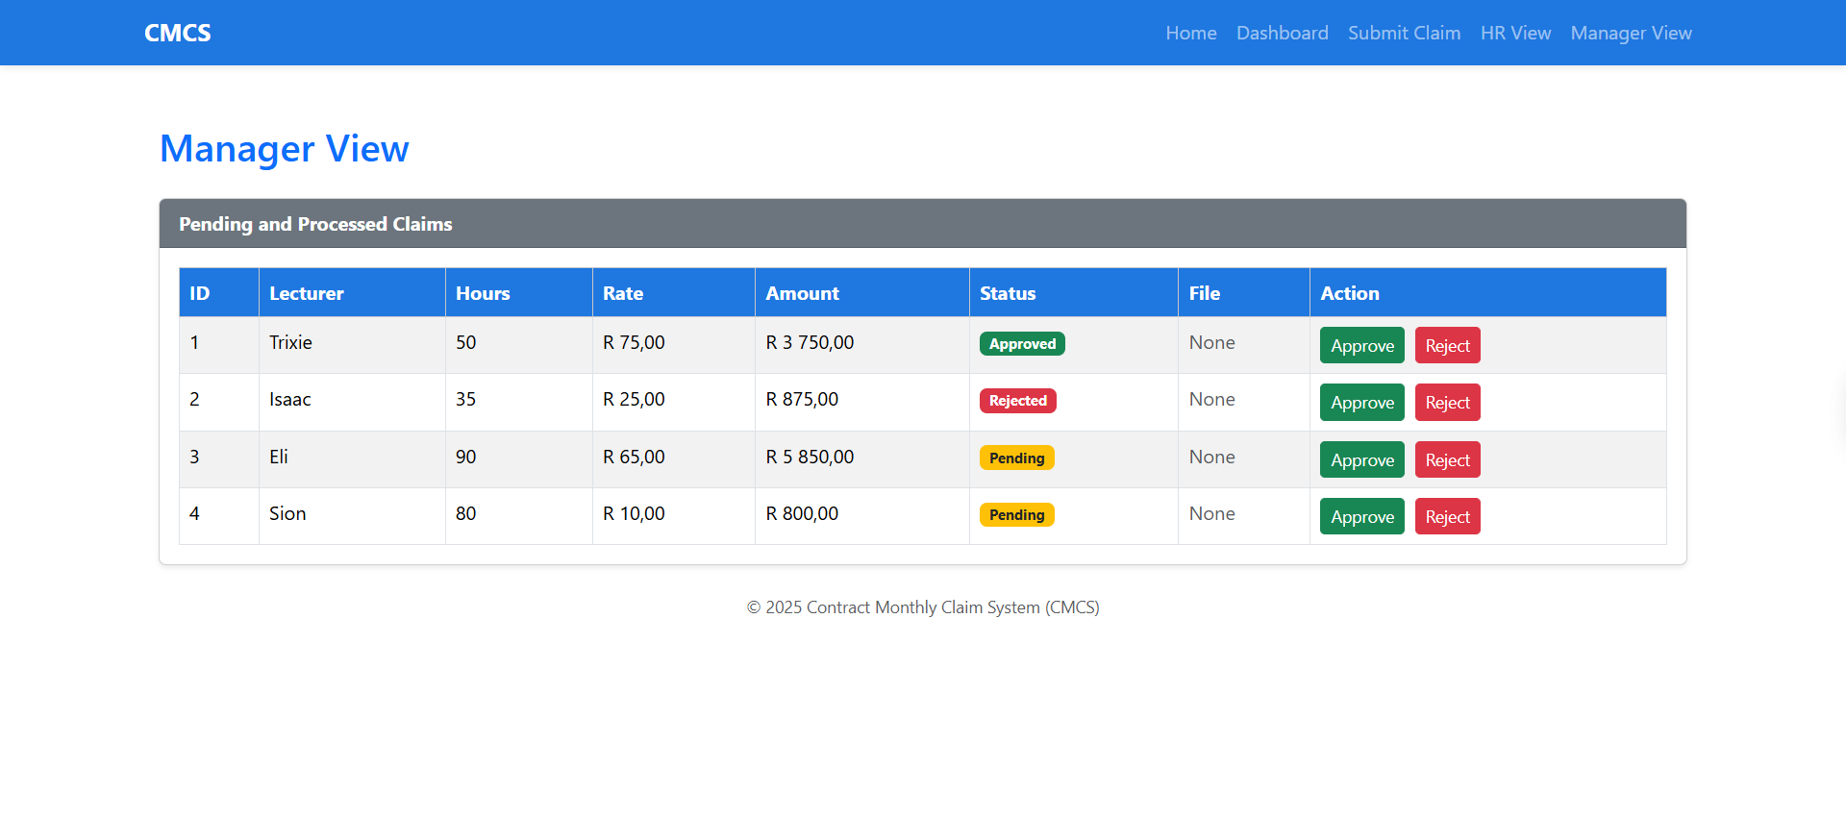

Slide 12
HR View - Automation & Reporting
HR has their own HR Dashboard page
The system automatically calculates:
Total number of claims
Count of approved, pending and rejected claims
Total approved amount to pay lecturers
I added a Chart.js bar chart to show:
Approved amounts per lecturer
HR can also download a CSV file of approved claims for payroll

Slide 13
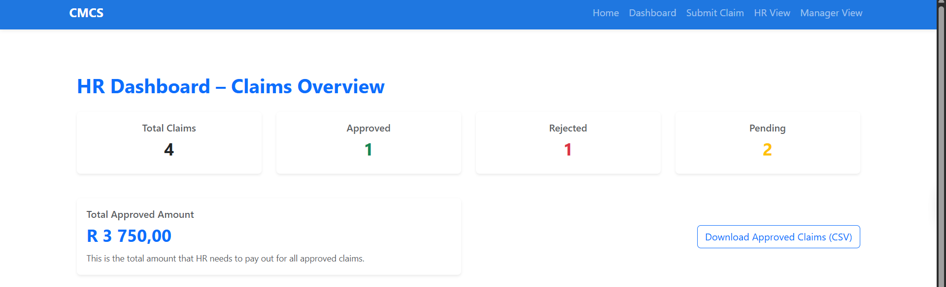
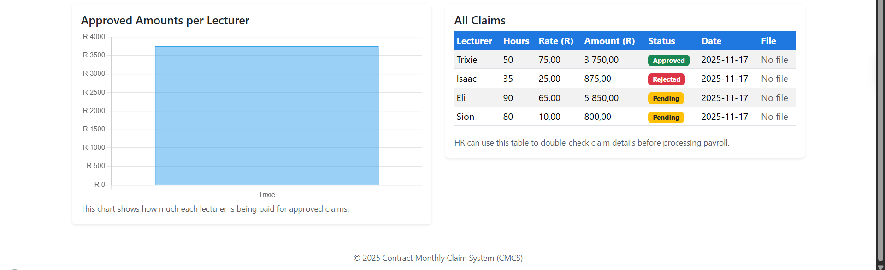

Slide 14
Validation, Security & Error Handling
I used ASP.NET model validation to make sure important fields are completed
Client-side and server-side checks:
Required fields
Numeric validation on hours and rate
Document upload improvements:
Only PDF, DOCX and XLSX are allowed
Max size: 5 MB
Invalid files show clear error messages
Status changes and navigation are controlled so users always see updated information
If something fails, the user stays on the same page with their data still visible

Slide 15
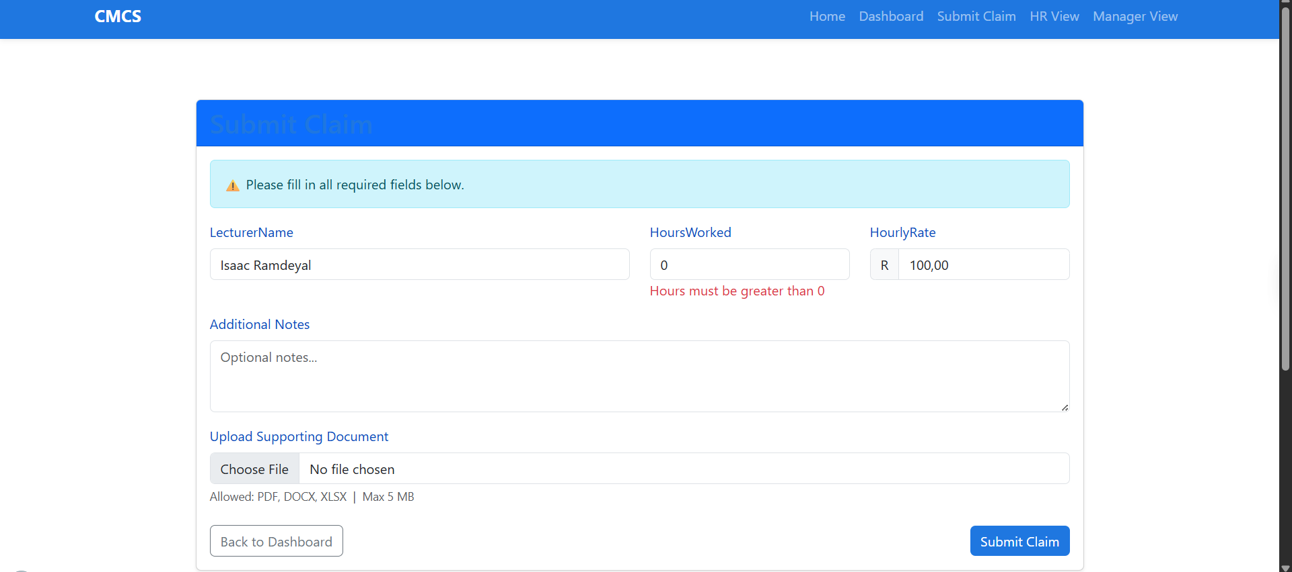

Slide 16
Tools, Technologies & Version Control
Technologies used:
ASP.NET Core MVC
C#
Razor Views
Bootstrap for styling
Chart.js for the HR chart
Development tools:
Visual Studio
.NET SDK
Version control:
Git / GitHub
Multiple commits with clear messages describing each change

Slide 17
Reflection & Conclusion
I learned how to build a structured MVC web application from start to finish
I improved my understanding of:
Controllers, views and models
Validation and file uploads
How to design separate views for different roles
The automation I added:
Saves time for lecturers, managers and HR
Reduces manual errors and miscommunication
If I had more time, I would:
Connect to a real SQL database
Add user authentication and role-based login
Expand reporting and analytics

Slide 18
References
Microsoft (2023). ASP.NET Core MVC Documentation.
Microsoft (2024). ASP.NET Core Data Validation.
Pieterse, V. (2022). Introduction to Software Engineering: Principles and Practice.
W3Schools, TutorialsTeacher, etc.

Slide 19
Thank you

